Slide 1
Atoms & the Periodic Table

Slide 2
Models of the Atom over Time
5-1 – Atomic Theory
How we think of the structure of the atom has changed over time
Through experimentation and a collection of evidence we now have a more detailed understanding of the atom

Slide 3
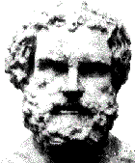
Democritus (400 B.C.)
5-1 – Atomic Theory
Proposed that matter was composed of tiny indivisible particles
Not based on experimental data
Greek: atomos

Slide 4
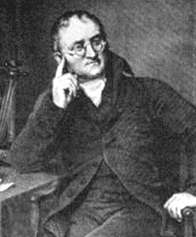
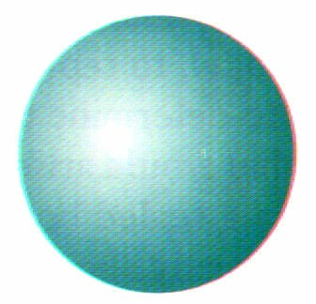
John Dalton (1807)
5-1 – Atomic Theory
British Schoolteacher
  based his theory on others’ experimental data
Billiard Ball Model
  atom is a
  uniform,
  solid sphere

Slide 5
John Dalton
5-1 – Atomic Theory
Dalton’s Atomic Theory
1. Elements are composed of small indivisible particles called atoms.
2. Atoms of the same element are identical. Atoms of different elements are different.
3. Atoms of different elements combine together in simple proportions to create a compound.
4. In a chemical reaction, atoms are rearranged, but not changed.

Slide 6
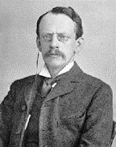
J. J. Thomson (1903)
5-1 – Atomic Theory
Cathode Ray Tube Experiments
  beam of negative particles
Discovered Electrons
  negative particles within the atom
Plum-pudding Model

Slide 7
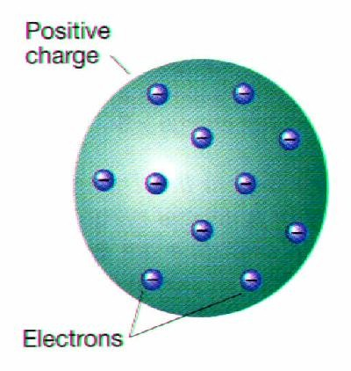
J. J. Thomson (1903)
5-1 – Atomic Theory
Plum-pudding Model
  positive sphere (pudding) with
  negative electrons (plums) dispersed throughout

Slide 8
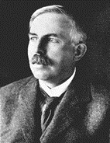
Ernest Rutherford (1911)
5-1 – Atomic Theory
Gold Foil Experiment
Discovered the nucleus
  dense, positive charge in the center of the atom
Nuclear Model

Slide 9
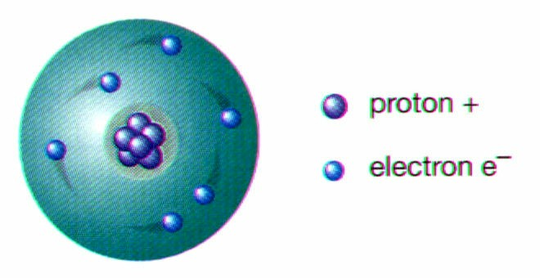
Ernest Rutherford (1911)
5-1 – Atomic Theory
Nuclear Model
  dense, positive nucleus surrounded by negative electrons

Slide 10
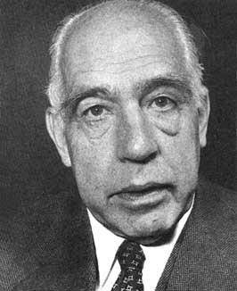
Niels Bohr (1913)
5-1 – Atomic Theory
Bright-Line Spectrum
  tried to explain presence of specific colors in hydrogen’s spectrum
Energy Levels
  electrons can only exist in specific energy states
Planetary Model

Slide 11

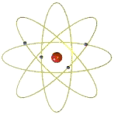
Niels Bohr (1913)
5-1 – Atomic Theory
Bright-line spectrum
Planetary Model
  electrons move in circular orbits within specific energy levels

Slide 12
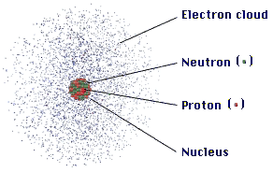
Current Atomic Model
5-1 – Atomic Theory
Electron Cloud Model (orbital)
dots represent probability of finding an e⁻
not actual electrons

Slide 13
5-1 – Atomic Theory
Structure of the Atom
Matter is anything that takes up space and has mass.
All matter is made of atoms
Atoms are made of several types of tiny particles.
The number of each of these particles in an atom is what makes atoms different from each other.
If you could multiply the width of an atom by 100 million, it would be the size of an orange.

Slide 14
5-1 – Atomic Theory
Structure of the Atom
The nucleus is the region at the center of an atom that contains most of the mass of the atom.
Two kinds of particles make up the nucleus—protons and neutrons.
A proton is a positively charged particle in the nucleus of an atom.
A neutron is an uncharged particle in the nucleus of an atom.

Slide 15
5-1 – Atomic Theory
Structure of the Atom
An electron cloud is the region surrounding an atom’s nucleus where one or more electrons are most likely to be found.
Electrons occupy certain areas around the nucleus according to their energy.

Slide 16
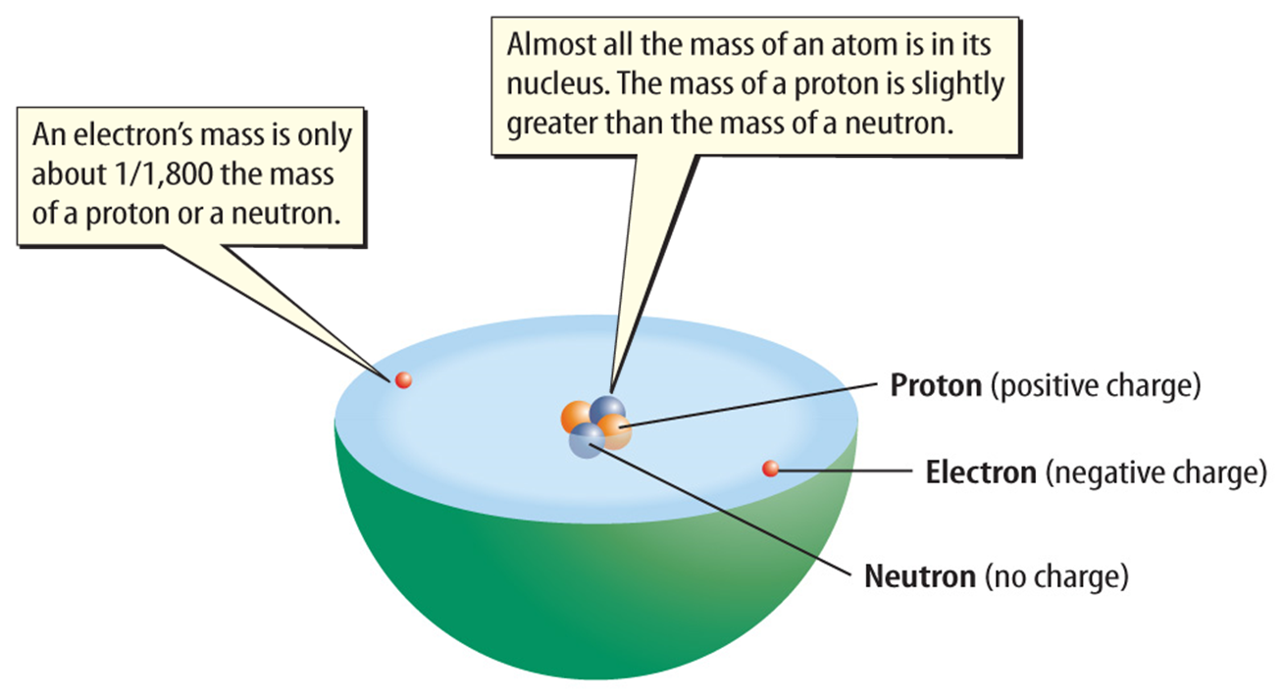
5-1 – Atomic Theory
Structure of the Atom

Slide 17

5-1 – Atomic Theory
Structure of the Atom
Where are protons, neutrons, and electrons located in an atom?

Slide 18
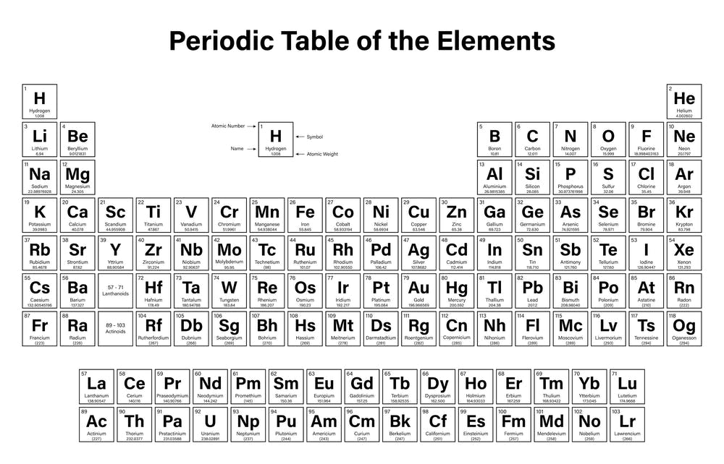
5-1 – Atomic Theory
Structure of the Atom
The periodic table can help us to figure out how many protons, electrons, and neutrons are in an atom.

Slide 19
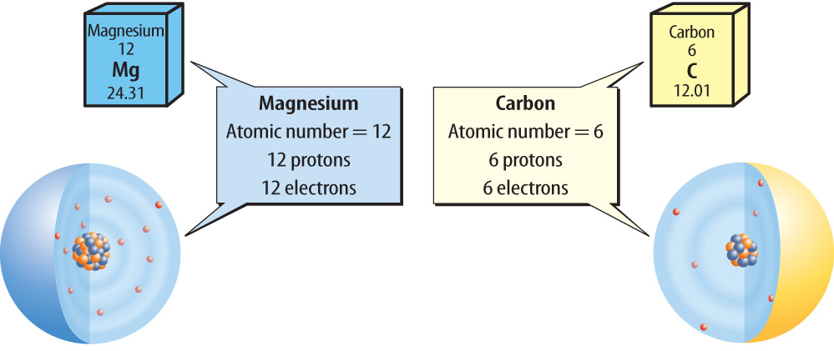
5-1 – Atomic Theory
Structure of the Atom
The atomic number is the number of protons in the nucleus of an atom of an element.
You can identify an element if you know either its atomic number or the number of protons its atoms have.

Slide 20
5-1 – Atomic Theory
Structure of the Atom
Neutral atoms have the same number of protons and electrons.
Once you know the number of protons, you also know the number of electrons

Slide 21
5-1 – Atomic Theory
Structure of the Atom
Neutral atoms have the same number of protons and electrons.
Once you know the number of protons, you also know the number of electrons

Slide 22
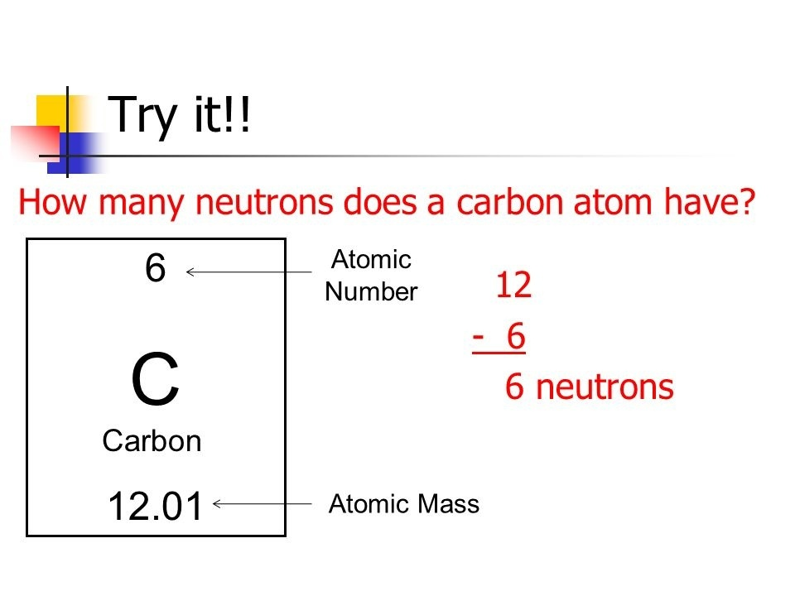
5-1 – Atomic Theory
Structure of the Atom
The mass number is the number of protons and neutrons in the nucleus of an atom.
To find the number of neutrons in an atom, you round the mass number and subtract the atomic number.

Slide 23
5-1 – Atomic Theory
Let’s Practice Finding Particles!!!
Find the Protons, Electrons, and Neutrons for the following atoms.
Lithium (Li)
P=
E=
N=
Oxygen (O)
P=
E=
N=

Slide 24
5-1 – Atomic Theory
Let’s Practice Finding Particles!!!
Find the Protons, Electrons, and Neutrons for the following atoms.
Sodium (Na)
P=
E=
N=
Argon (Ar)
P=
E=
N=

Slide 25
5-1 – Atomic Theory
Structure of the Atom
How can you find out the number of protons, neutrons, and electrons located in an atom?

Slide 26
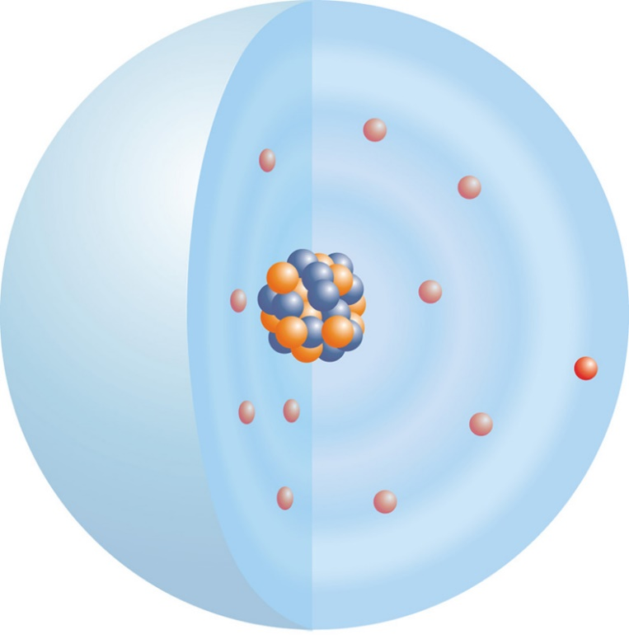
5-1 – Atomic Theory
Structure of the Atom
Electrons have special rules on how they fit into the electron cloud
Electrons close to the nucleus are strongly attracted to it and have less energy.
Electrons farther from the nucleus are less attracted to it and have more energy.

Slide 27
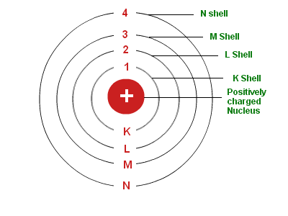
5-1 – Atomic Theory
Structure of the Atom
Electrons stay in something called shells or energy levels.
Only so many can be in any certain shell or energy level.
K holds 2 electrons
L holds 8 electrons
M holds 8 electrons
N holds 18 electrons

Slide 28
5-1 – Atomic Theory
Let’s Practice Drawing Atoms!!!
Steps to Draw an Atom:
Find the particles (PEN) for a given Atom.
Draw the nucleus and put in protons and neutrons.
Start electron shells with K. Fill lower shells before going to bigger shells. Remember how many fit on each shell.

Slide 29
5-1 – Atomic Theory
Let’s Practice Drawing Atoms!!!
Find the PEN for the following atom and then draw it.
Hydrogen (H)
P=
E=
N=

Slide 30
5-1 – Atomic Theory
Let’s Practice Drawing Atoms!!!
Find the PEN for the following atom and then draw it.
Lithium (Li)
P=
E=
N=

Slide 31
5-1 – Atomic Theory
Let’s Practice Drawing Atoms!!!
Find the PEN for the following atom and then draw it.
Nitrogen (N)
P=
E=
N=

Slide 32
5-1 – Atomic Theory
Let’s Practice Drawing Atoms!!!
Find the PEN for the following atom and then draw it.
Magnesium (Mg)
P=
E=
N=

Slide 33
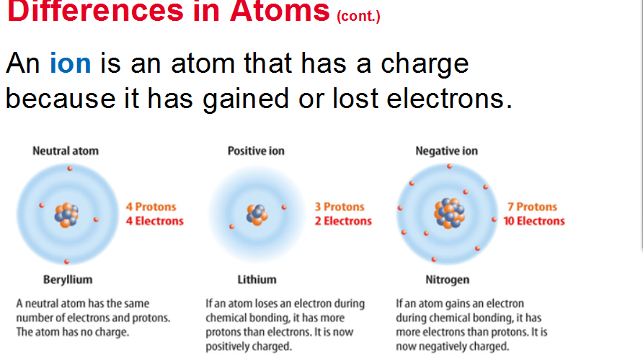
5-1 – Atomic Theory

Slide 34
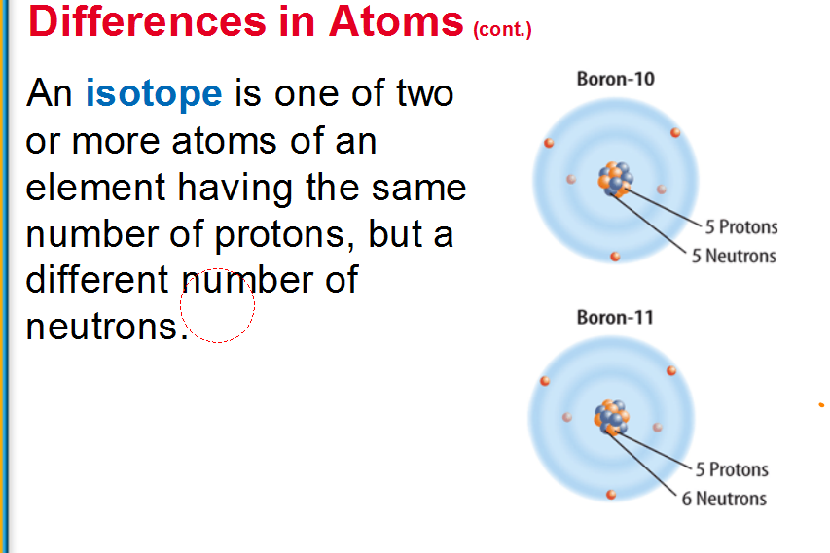
5-1 – Atomic Theory

Slide 35
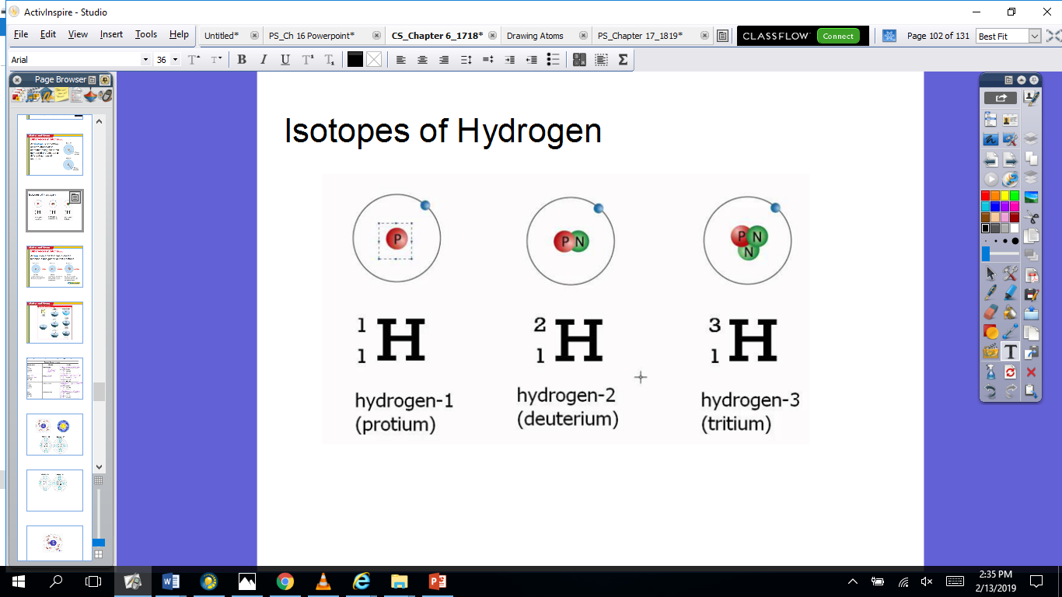
5-1 – Atomic Theory

Slide 36
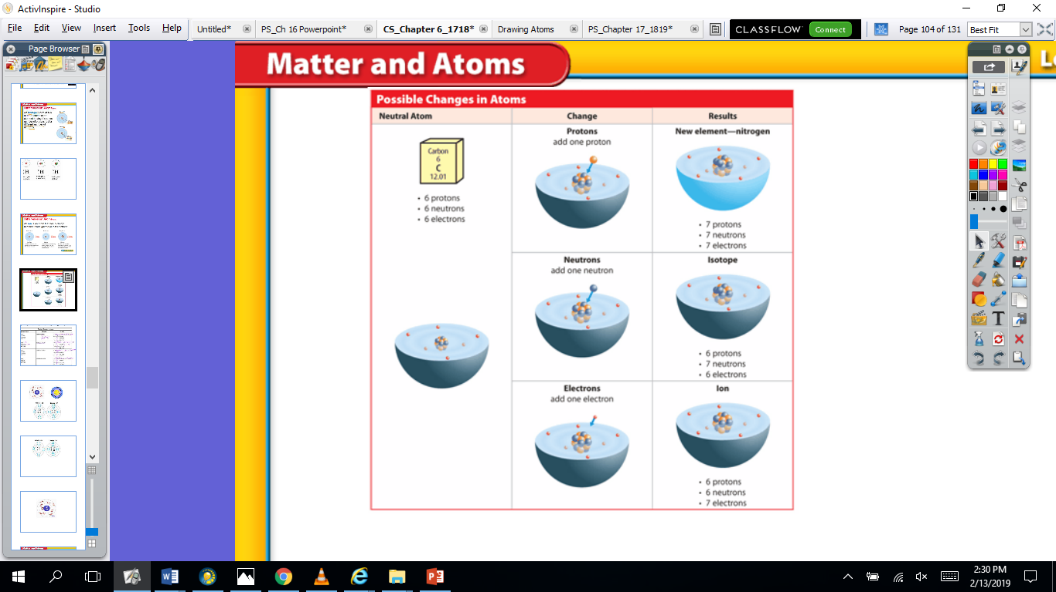
5-1 – Atomic Theory

Slide 37
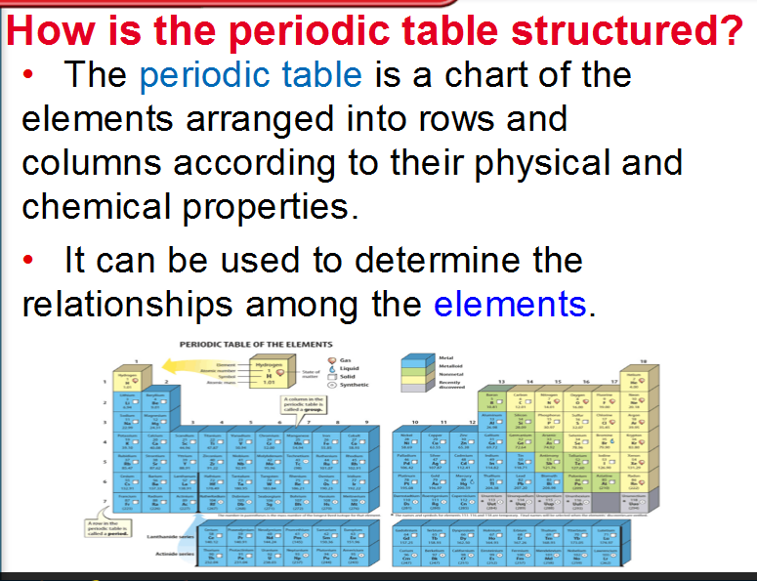
5-2 – The Periodic Table

Slide 38
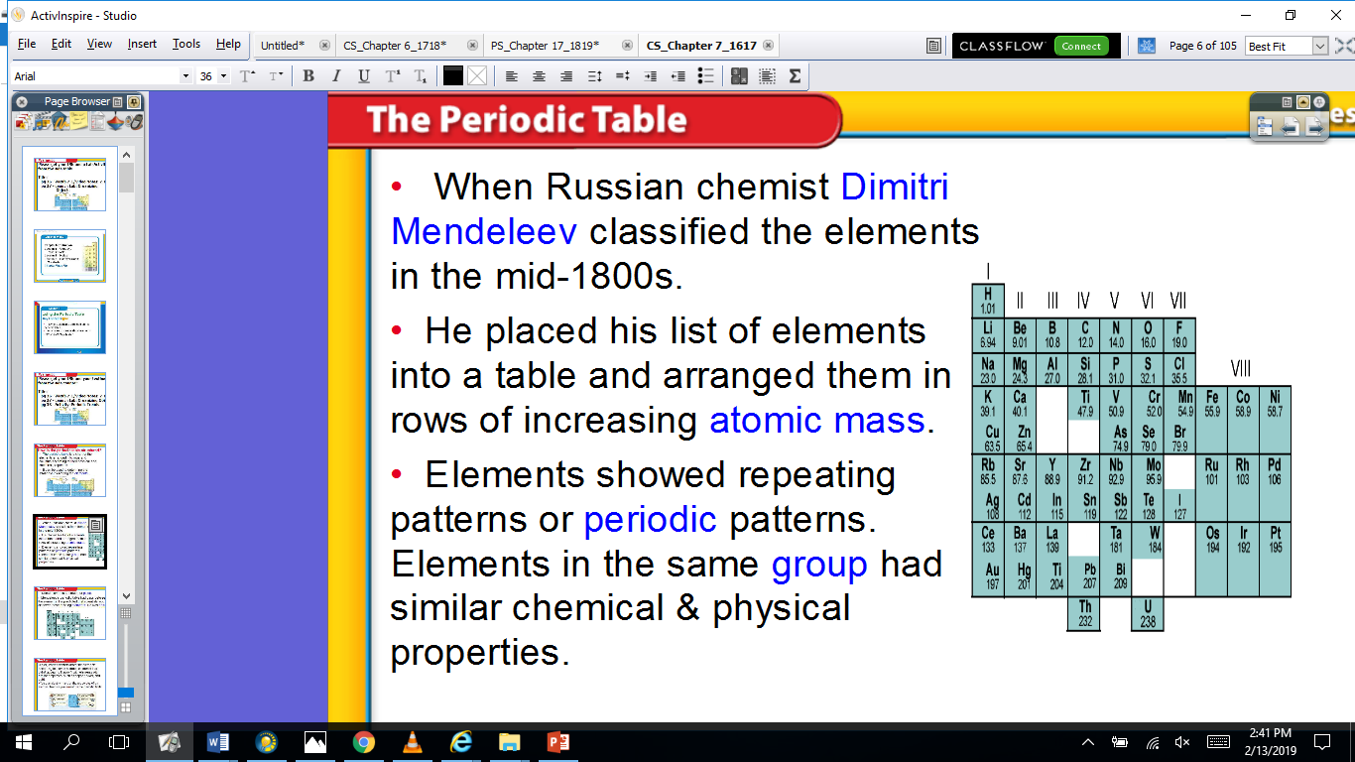
5-2 – The Periodic Table

Slide 39
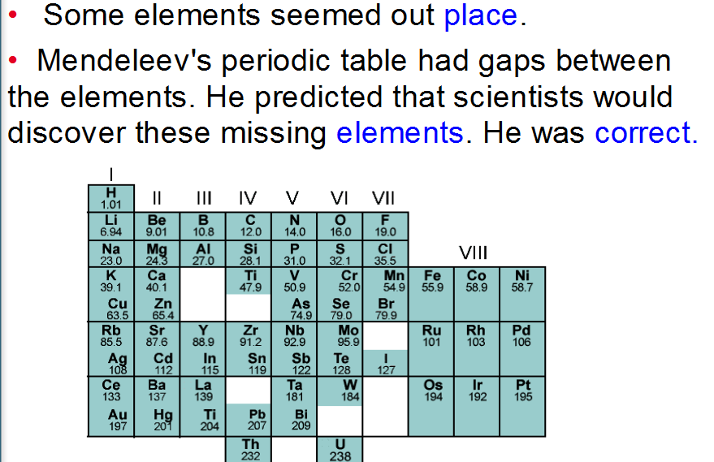
5-2 – The Periodic Table

Slide 40
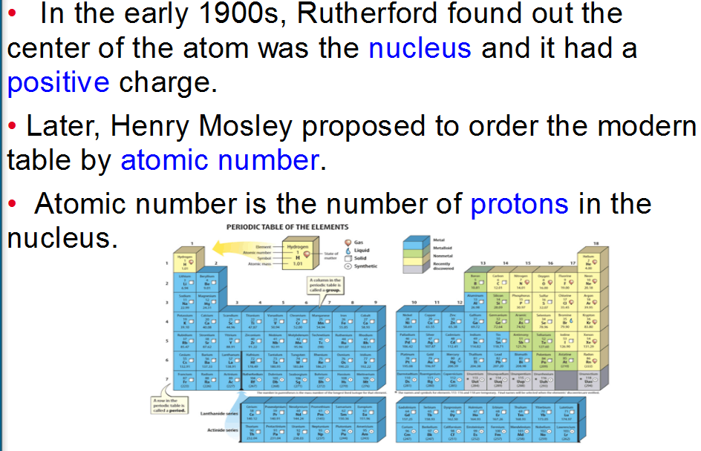
5-2 – The Periodic Table

Slide 41
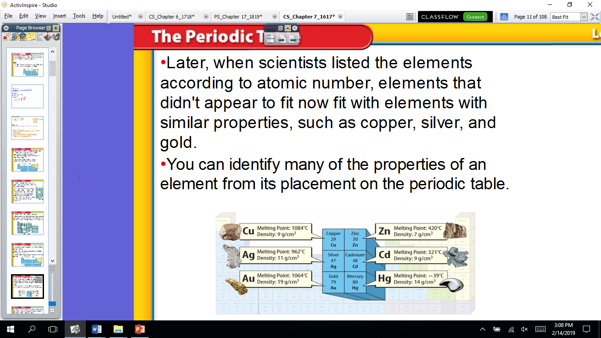
5-2 – The Periodic Table

Slide 42
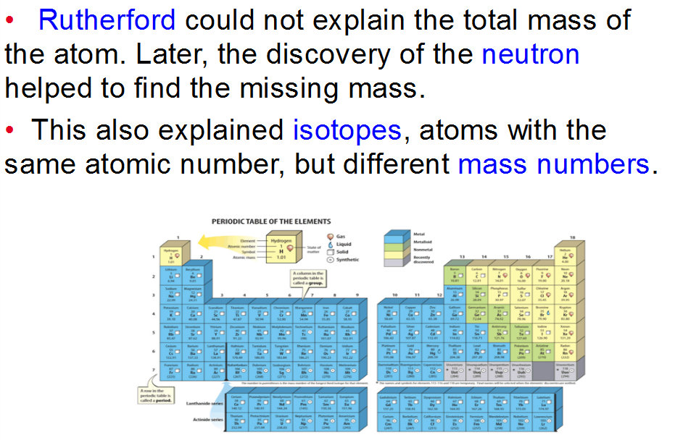
5-2 – The Periodic Table

Slide 43
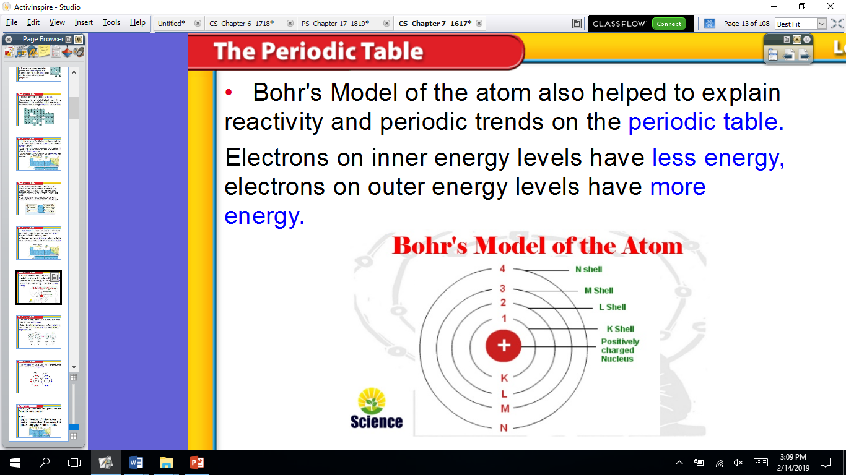
5-2 – The Periodic Table

Slide 44
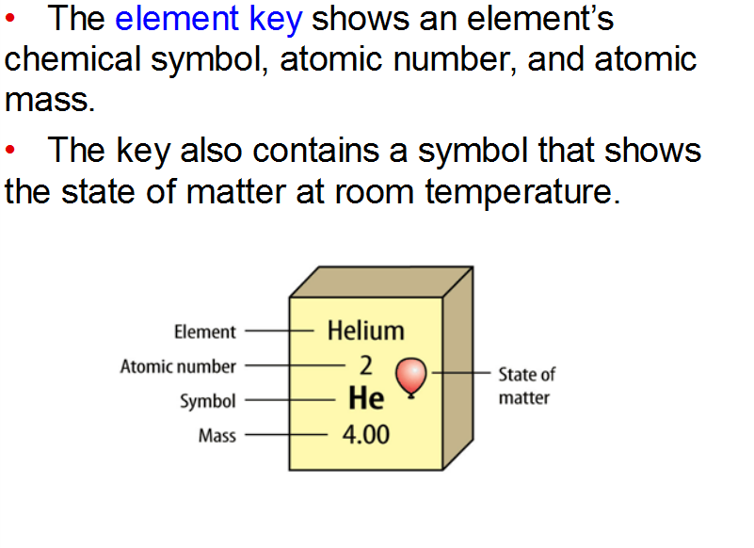
5-2 – The Periodic Table

Slide 45
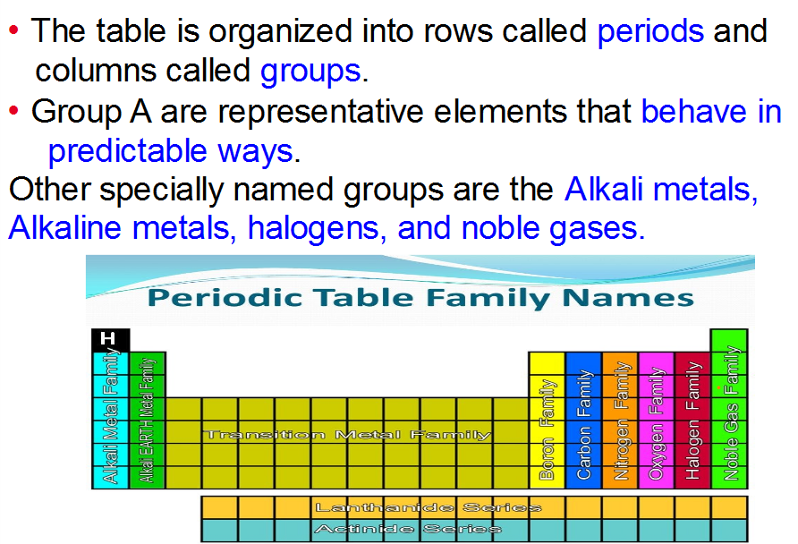
5-2 – The Periodic Table

Slide 46
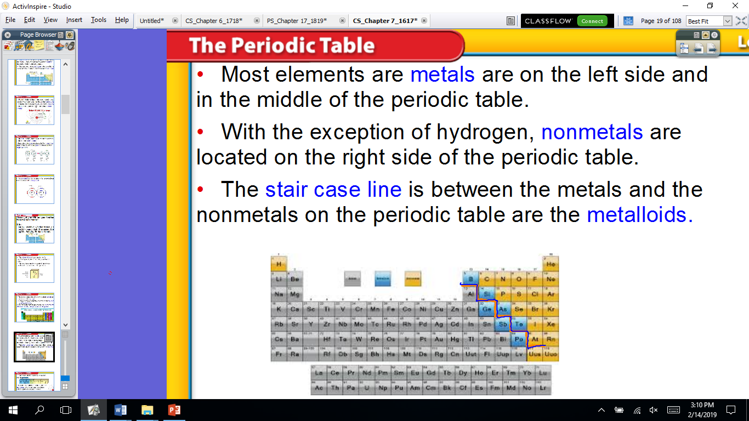
5-2 – The Periodic Table

Slide 47
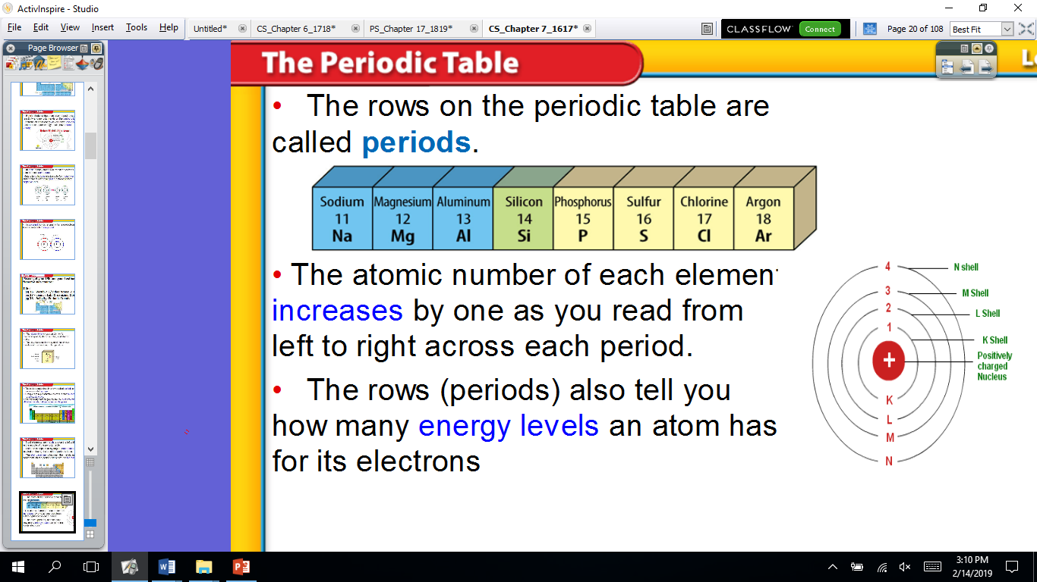
5-2 – The Periodic Table

Slide 48
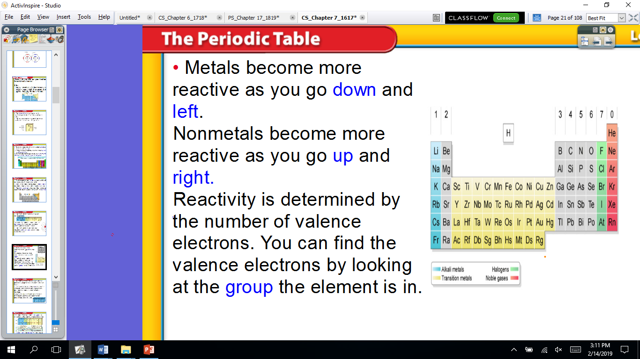
5-2 – The Periodic Table

Slide 49
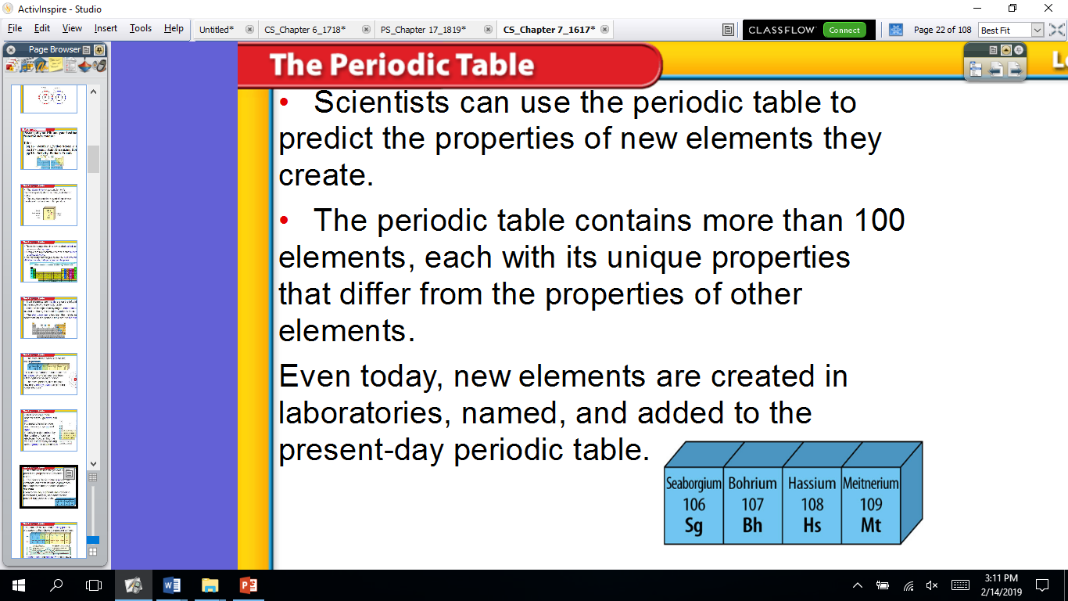
5-2 – The Periodic Table

Slide 50
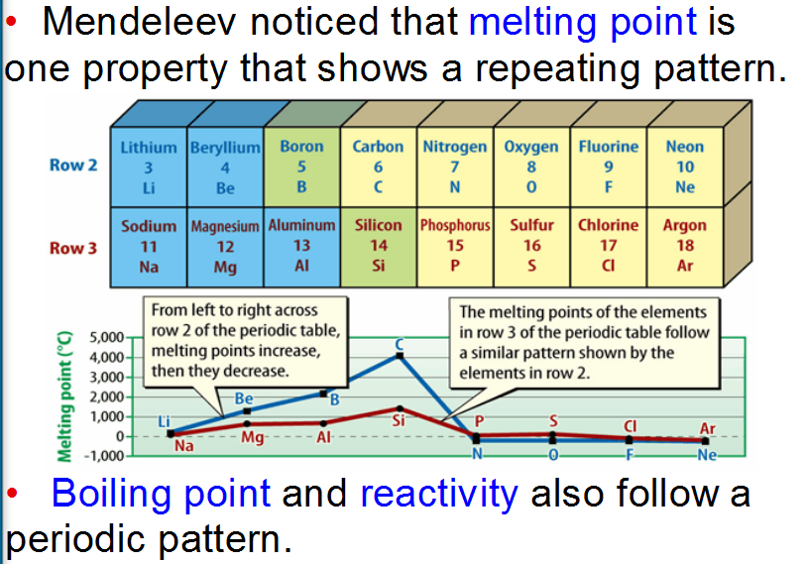
5-2 – The Periodic Table

Slide 51
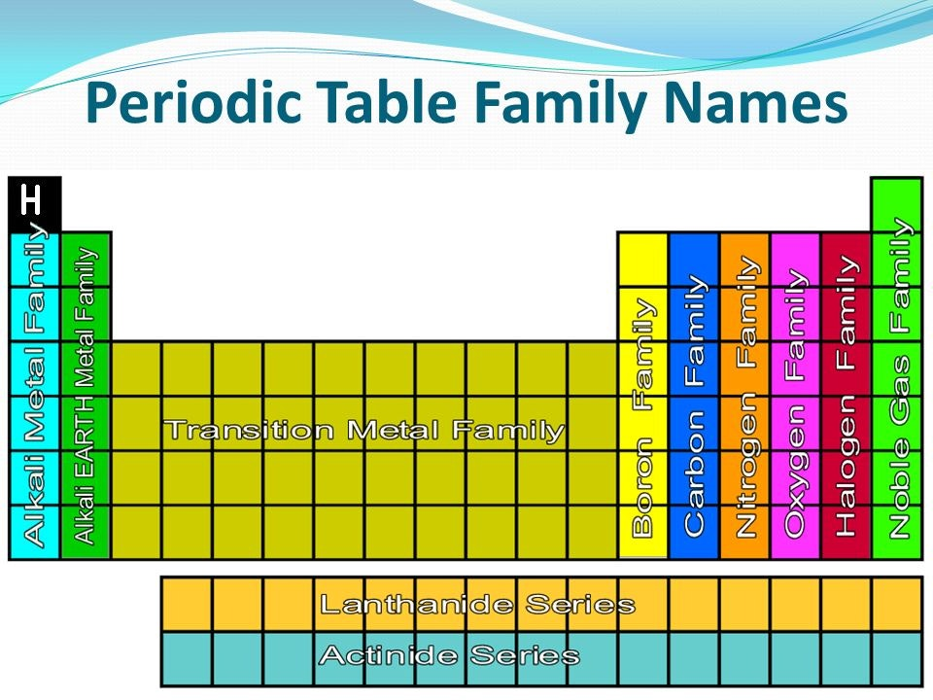
5-2 – The Periodic Table

Slide 52
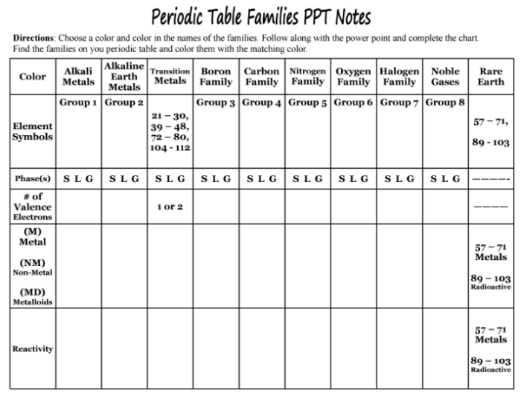
5-2 – The Periodic Table
1,3,11,19,37,55,87
4,12,20,38,56,88
5,13,31,49,81
6,14,32,50,82
7,15,33,51,83
8,16,34,52,84
9,17,35,53,85
2,10,18,36,54,86
1
2
3
4
5
6
7
8
NM - H
M
M
M
MD
M
NM
M
NM
MD
M
NM
MD
M
NM
MD
NM
Most reactive
Metallic group
Next Most reactive
Metallic group
Less reactive
Than group 2
Less reactive
Than transition metals
Less reactive
Than group 3
Less reactive
Than group 4
More reactive
Than group 5
Most reactive
Nonmetallic group
Least reactive group

Slide 53
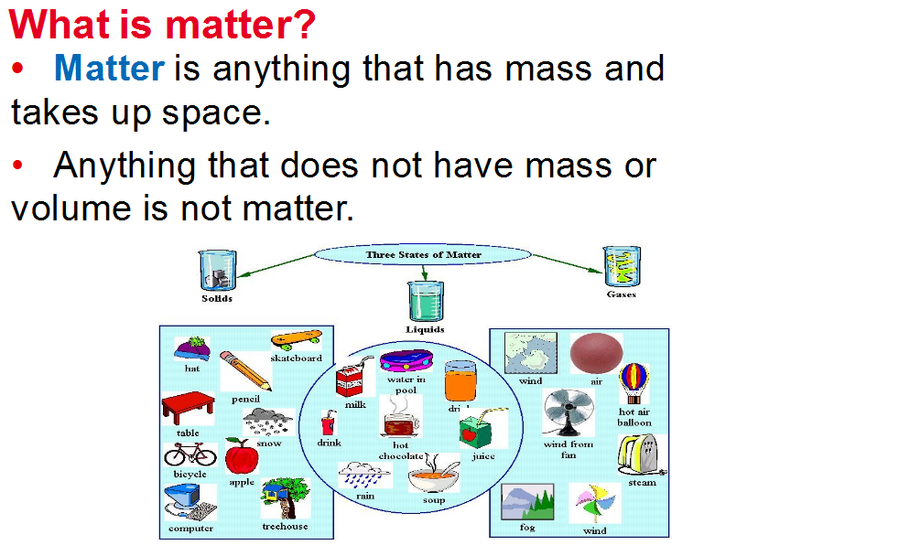
Classifying Matter

Slide 54
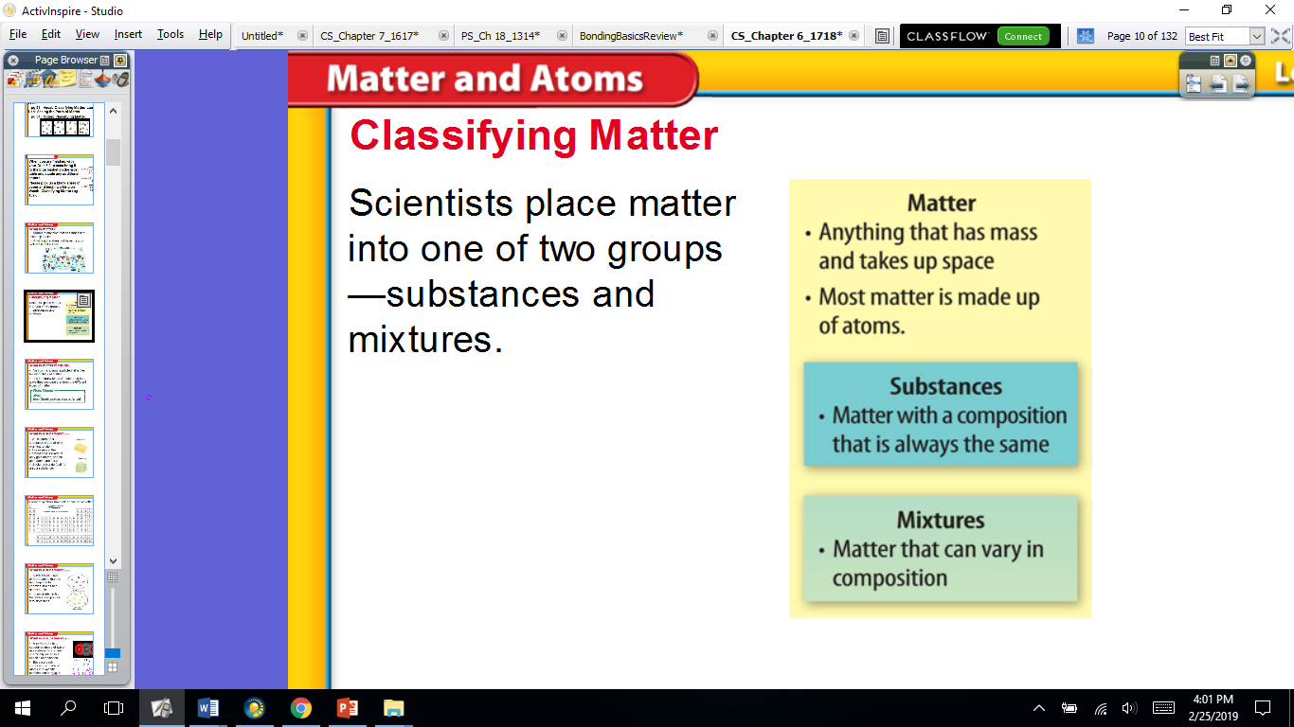
Classifying Matter

Slide 55
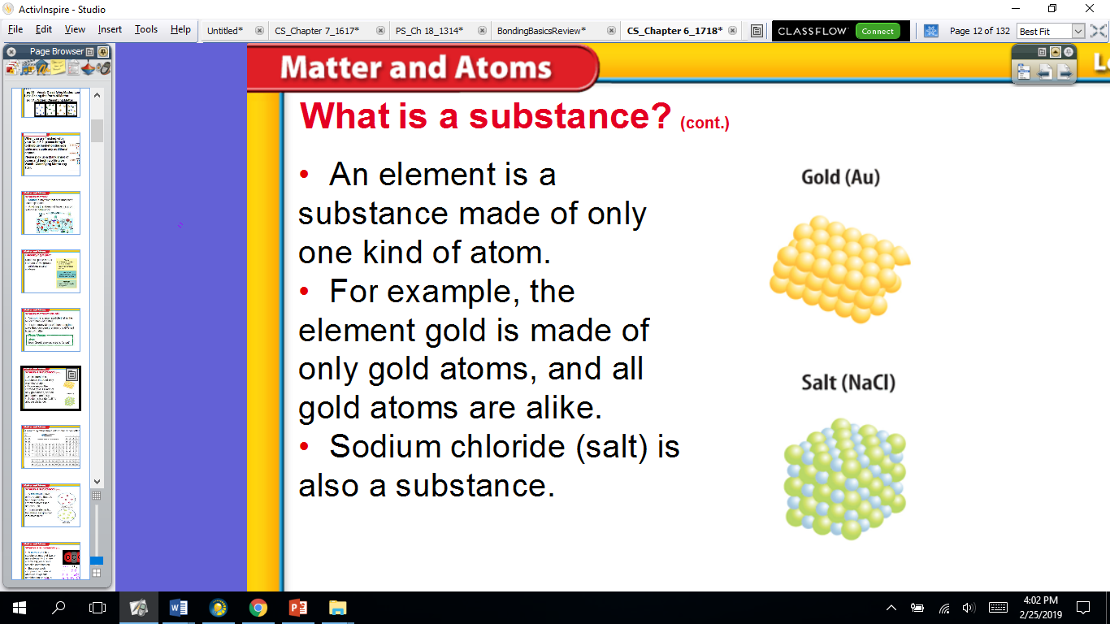
Classifying Matter

Slide 56
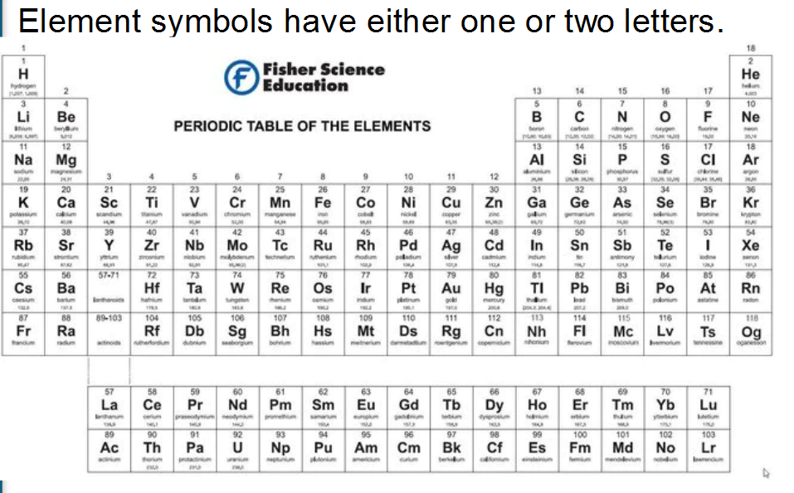
Classifying Matter

Slide 57
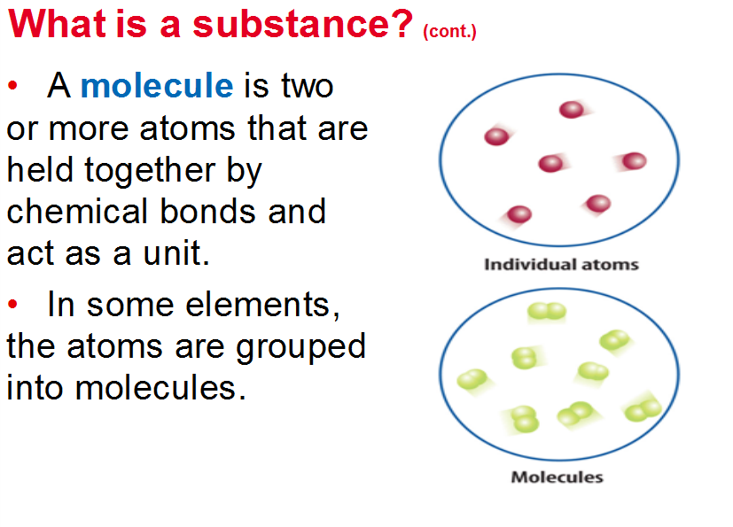
Classifying Matter

Slide 58
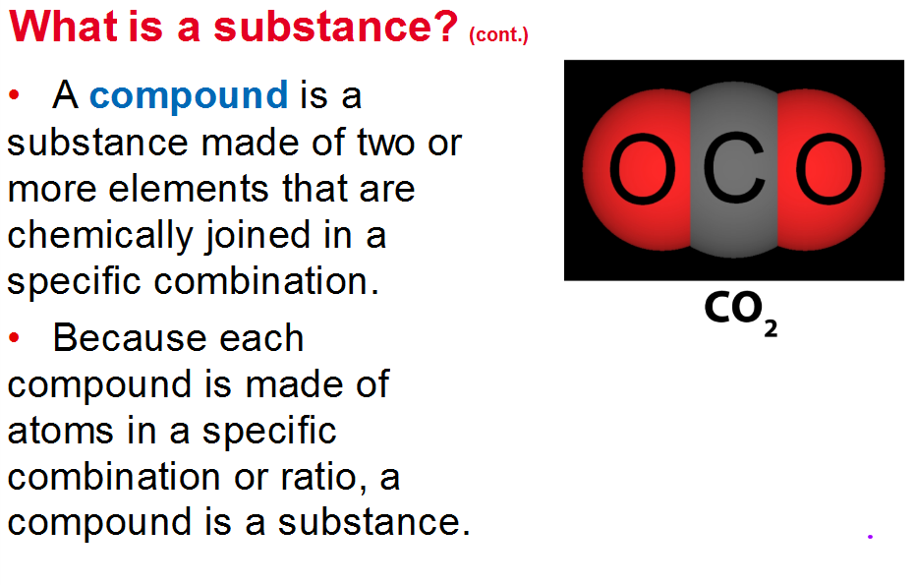
Classifying Matter

Slide 59
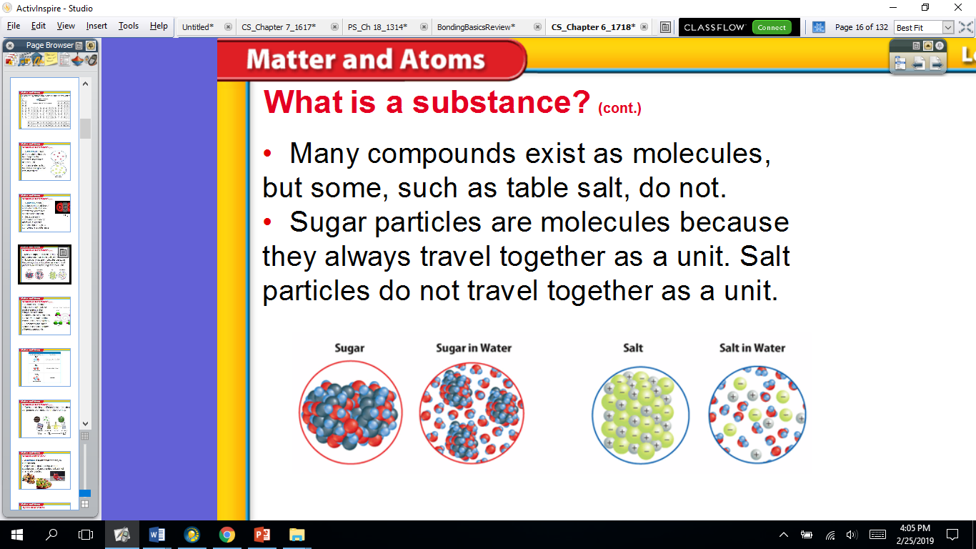
Classifying Matter

Slide 60
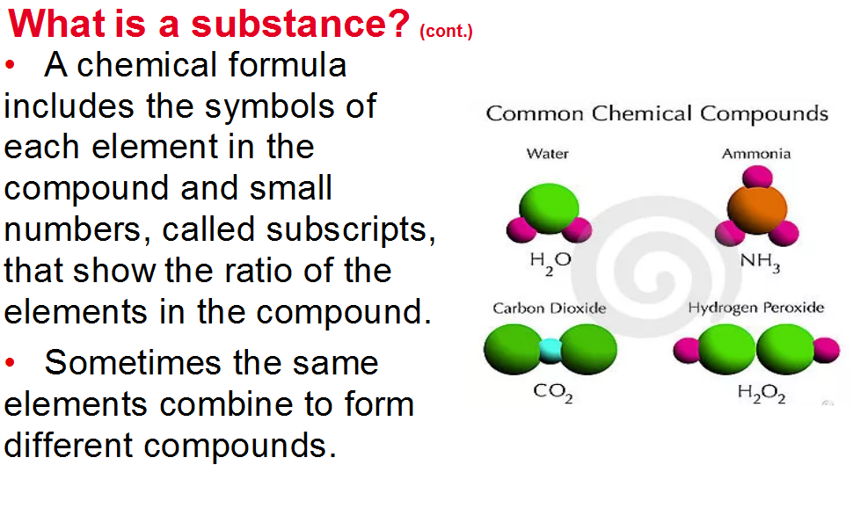
Classifying Matter

Slide 61
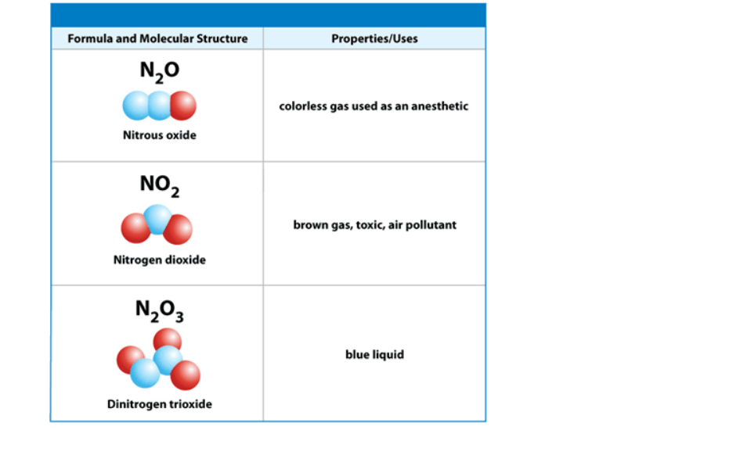
Classifying Matter

Slide 62
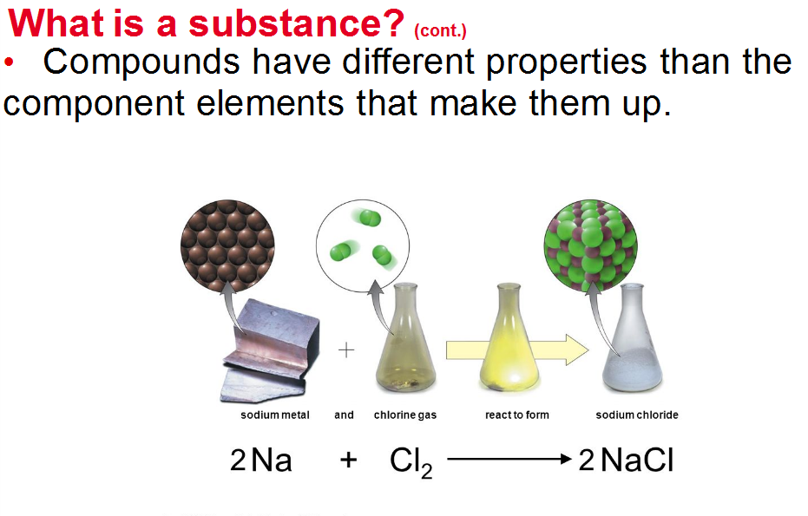
Classifying Matter

Slide 63
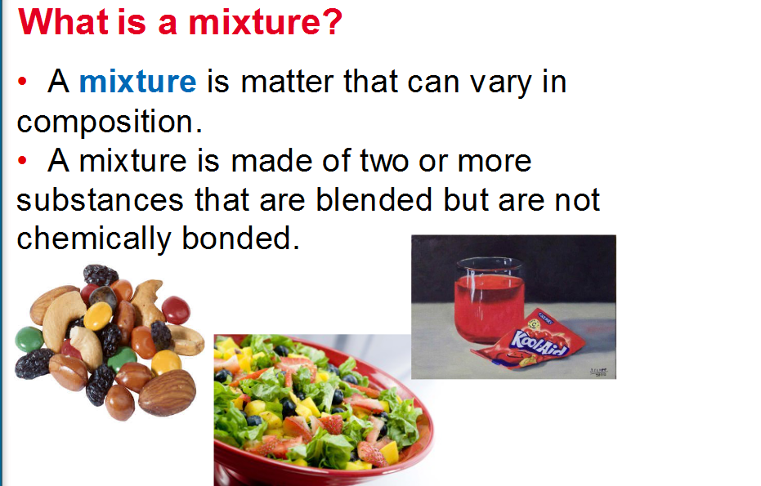
Classifying Matter

Slide 64
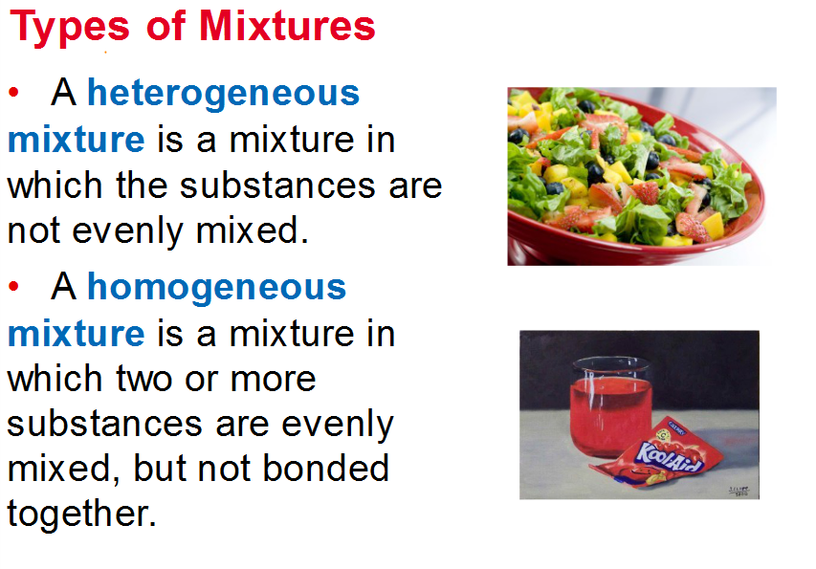
Classifying Matter

Slide 65
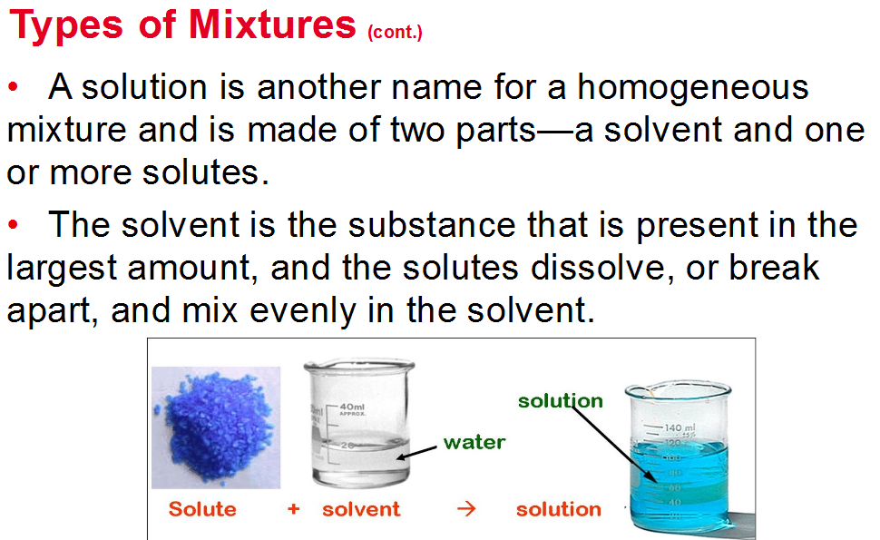
Classifying Matter

